Slide 1
UNIT 4 INTRODUCTION OF IPR

Slide 2
Classification of Property
Property
Tangible
(Physical Goods)
Intangible
(Non-Physical)
Movable
(Jewellery, Vehicle)
Immovable
(House, Factory)
Intellectual
(Patent, Trademark)
Securities
(Debt security, Equity)
Right to individual reputation (Character, Ethics)

Slide 3
Classification of Intellectual Property
Industrial Property
Patent
Trademarks
Industrial Design
Layout design of integrated circuits
Literary Property
Copy rights
Neighbouring rights
Performer’s rights (Singing, Drama)
Broadcasting rights
(Sports, News, Music in TV/Radio)
Product
Process

Slide 4
What is a Patent?
A form of intellectual property granted to applicant(s) who claims to be the first inventor(s) for providing solution to a problem in a particular field.
A patent is an exclusive right awarded for an invention/innovation for a product/process.
It is a techno-legal document describing the invention and also providing details of inventors.

Slide 5
What is the use of a patent (for the applicant)?
A granted patent gives legal rights to applicant(s) to exclude others from making, using, selling (for a period of 20 years).
It authorizes the applicant to use invention/innovation for making/selling/Technology Transfer etc.
It gives rights to applicant to take legal action against any person exploiting his invention.

Slide 6
Patent Law
Patent law in India is governed by Patent Act 1970.
Indian patent can be filed in the prescribed format in the patent office by applicant or authorized patent agent or attorney (lawyer).
A granted patent is valid only in the particular jurisdiction where it is sanctioned.
To get a patent granted from other country, application should be submitted in that country through Patent Cooperation Treaty (PCT) or Conventional route.
Indian patent offices are located in Chennai, New Delhi, Mumbai, Kolkata.

Slide 7
Copyright
Copyright is an exclusive right awarded for creation of literary work, artistic work, dramatic work, musical work, to an author/composer to print/publish/sell his original work.
Copyright is issued by Copyright office.
Copyright is awarded to a work that is original.
Copyright in India is located in New Delhi.
Copyright laws are governed by Copyright Act 1957.

Slide 8
Typical examples of Copyright
Original literary works
(Tasler, words, codes)
Original Dramatic works
(Recitation, Acting, Choreography)
Original Musical works
Original Artistic works
(Painting, Sculpture, Drawings, Photographs, Engravings, Crafts, Maps, Charts etc.,)
Original Cinematograph
(Visual recording in any medium, Sound recording, Video film etc.,)
Original software
(to use in literary work, drama, engineering design, sports/games etc.,)

Slide 9
Forms of Copyright
Reproduction right : A copyright owner can transfer ownership to others to reproduce contents of his work by means of an agreement with financial benefits
Translation Work and Adaptation Right : A copyright owner can transfer his ownership to others for translation (into other language) or adaptation ( a novel to a motion picture)
Neighboring Right : This includes : performing right(music/drama performance), Recording right(sound recording) and Motion picture right(Audiovisual), Broadcasting right(games, sports).

Slide 10
TRADEMARK(TM)
A trademark refers to any symbol or sign or letters or numerals or label used on a product to differentiate the owner from other competitors
Any organization or individual can register for the trademark
The laws of trademark is governed by Trademark Act 1999.
The trademark is granted by Indian Trademark Registry(Office) located in Chennai, Mumbai, New Delhi and Kolkata.
A trademark is valid for a period of 10 years

Slide 11
CRITERIA FOR FILING TRADEMARK
Distinctiveness
(Eg Uber, Ola)
Absence of phonetic similarity
(Eg Glucovita
Glukoveta)
Absence of visual similarity
Should not be name of a location (Eg Ooty, Chennai)
Should not be surname of a person
Eg Dhoni, Tendulkar
Should not be nature of a product
Eg Soap, Tea, Fan
(However it can be Hamam Soap, Assam Tea, Usha Fan)
Should not be a work describing quality of product
(Eg Excellent, Superb)

Slide 12






Typical Trademarks

Slide 13
Procedure for registering Trademark
Filing the Application
Issuance of Receipt
Examination Report
Accepted
Objected
Publication in Trademark
Journal
Reply to Examination Report
Accepted
Hearing / Discussion
Notice of opposition
Yes
Objection Proceedings
Refused / With draw
No
Renewal within 1 year from date of exp
Registration (For 10 Years)
Appellate Board

Slide 14
SERVICE MARK/COLLECTIVE MARK/CERTIFICATION MARK
Service Mark :
Service Mark is a trademark used to identify a service rather than a product.
It can be in the form of a word or phrase or symbol or combination of there elements
Collective Mark :
It is owned by an association or a professional body
For eg : Elsevier, IEEE
Certification Marks :
The certification mark is based on the standards of the good.
For eg : ISI, Agmark

Slide 15


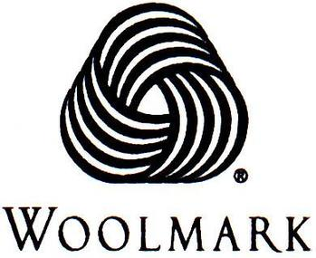



COLLECTIVE MARK / CERTIFICATION MARK

Slide 16
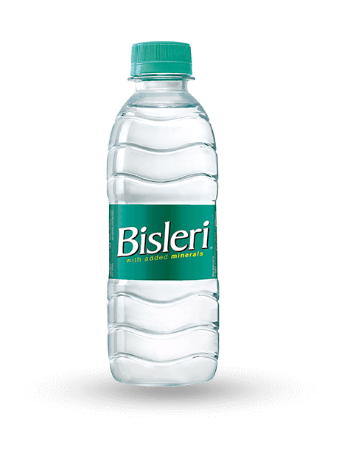
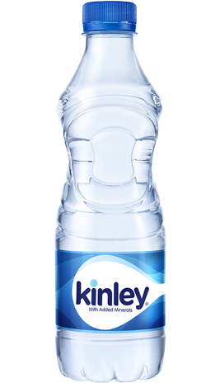
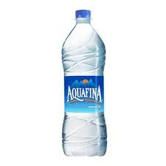
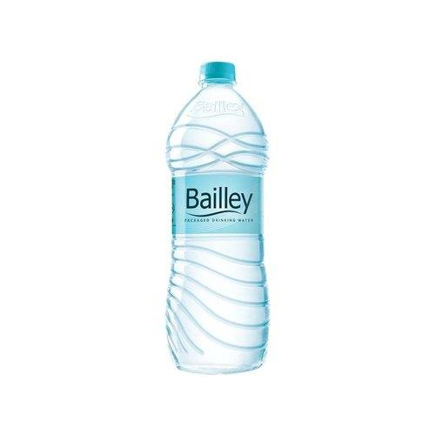
INDUSTRIAL DESIGN
Industrial design is expressed in the form of shapes, patterns, lines, colours etc.,
It prevents other manufacturers from producing similar articles with similar design
The laws of industrial design is governed by Industrial Design Act 2000
It is valid for 10 years and can be renewed for every 5 years
Head office is in Kolkata
Can be filed in Chennai, Delhi and Mumbai
Examples of Registered Industrial
Designs

Slide 17
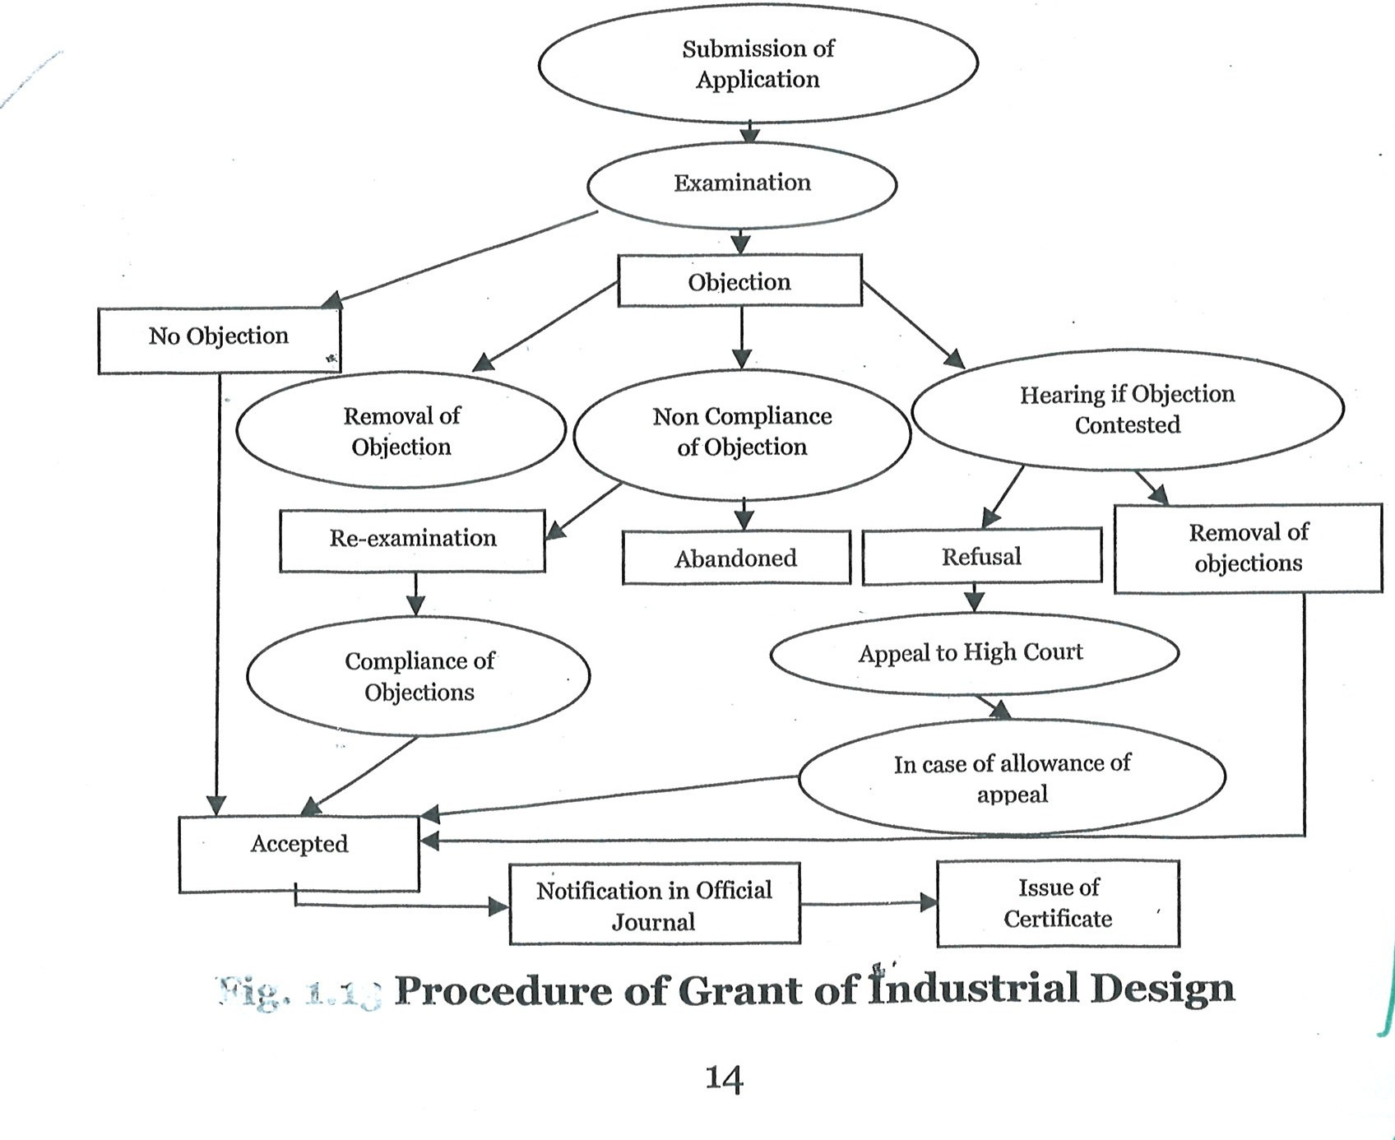
Procedure of Grant of Industrial Design

Slide 18
Difference between Copyright and Trademark
Copyright | Trademark
Registration of copyright is not mandatory before public use | Registration of industrial design is mandatory before public use
Copyright protection is provided until life of author plus sixty years | Industrial design protection is generally for a short period of time (10 years) and extended further to a period of 5 years.

Slide 19
Trade Secret
Trade secret is a formula, practice, process, commercial method or compilation of information in a product or process not generally known to public or reasonably ascertainable by others by which a business obtain an economical advantage over competitors.
Eg: Tirunelveli Halwa, Coco-cola, Tirupathi Laddu, KFC, Google
Unauthorised use of trade secret by any person in any office is regarded as an unfair practice and it is a violation of the company agreement.
Trade secrets are protected without any registration

Slide 20
Conditions for Trade Secret
Information must be secret
It must have commercial value
It must have subject to reasonable steps by rightful holder of the information to be kept as secret through confidentiality agreements

Slide 21
Comparsion of different IPR
IPR Type | Protect | Term or Period | Comparative Costs
Patent | Functional Aspects | 20 Years upon filing | Expensive
Industrial Design | Ornamental Features | 10 years upon filing + renewal every 5 years | Moderate
Trademark | Brands | 10 years upon filing +Renewal every 10 years | Inexpensive
Copyrights | Works of Authorship | Life Plus 60 years | Inexpensive
Trade Secrets | Information | Potentially Indefinite limited by secrecy | Depends

